Slide 1

AI-Powered
Marketing Content
Generator
A Streamlit web app that surfaces an OpenAI model for small-business marketing.
DSC670 Final Application
5/28/2026
Kayla Greavu
AI Marketing Content Generator • Streamlit Final Deliverable
01

Slide 2
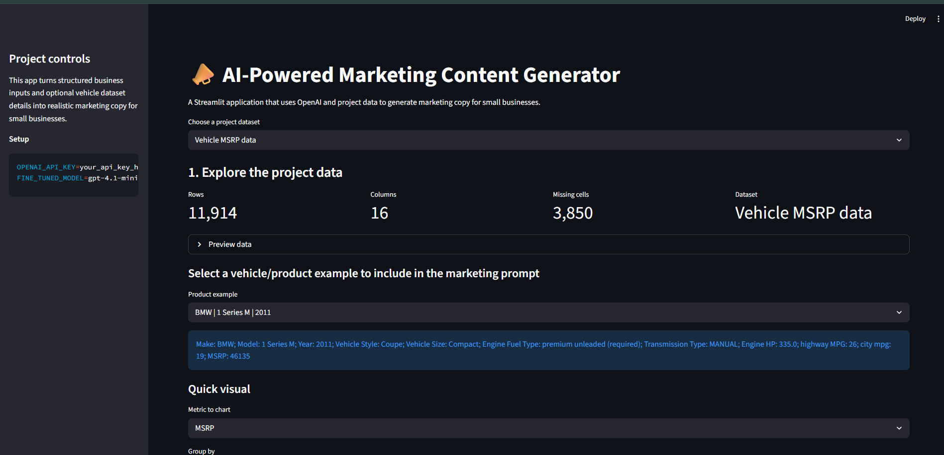
AI-Powered Marketing Home Page
AI-powered Streamlit application that transforms structured business and dataset inputs into realistic marketing content using OpenAI.

Slide 3
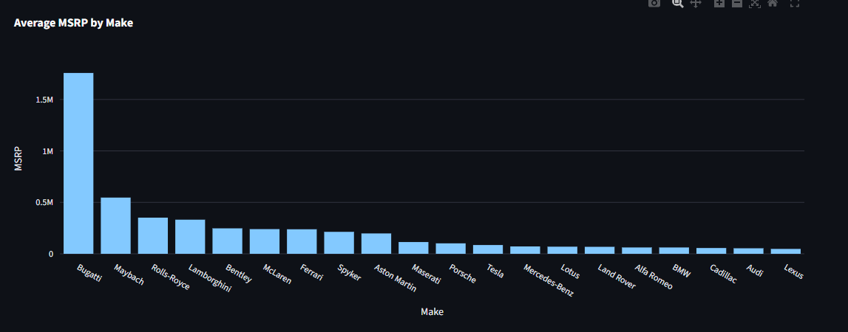
Project purpose
Build a practical app around the fine-tuned model instead of leaving the solution inside a notebook.
Prior work used Week 1 project proposal, fine-tuning milestone, and provided vehicle/car CSV data.
Final deliverable Python Streamlit code + PowerPoint with screenshots of the running app.
Problem
Small businesses often need regular social posts, ads, website copy, and email content but lack time, staff, or marketing expertise.
Solution
A Streamlit application collects structured business inputs and optional dataset context, then sends them to the fine-tuned marketing model.
The data supports product context and app demonstrations; the fine-tuned model produces the marketing content.
AI Marketing Content Generator • Streamlit Final Deliverable
02

Slide 4
Application workflow
The web app turns business inputs and dataset details into structured prompts for the fine-tuned model.
CSV data Vehicle/product rows
and quick visuals
Streamlit UI Business type, tone,
audience, CTA
Prompt builder Structured format
from milestone
Fine-tuned model Configured with
FINE_TUNED_MODEL
Marketing copy Social post, ad,
email, or web copy
Key design choice
The OpenAI call is isolated in `marketing_generator.py`, while `streamlit_app.py` focuses on interface, data display, and user flow.
AI Marketing Content Generator • Streamlit Final Deliverable
03

Slide 5
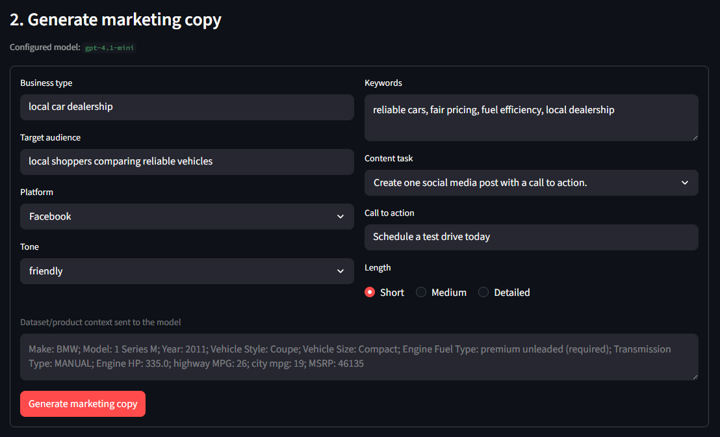
Streamlit app: data exploration
The first part of the app loads the provided CSVs and gives the user a product example to include in the prompt.
Data-driven prompt context
Users can select one of the car datasets, preview rows, and choose a vehicle/product record. The app converts that row into readable marketing context.
Why this matters It shows the project can combine tabular data, app controls, and model prompting in one workflow.
Portfolio value The app is readable, modular, and easy to explain in GitHub or during an interview.
AI Marketing Content Generator • Streamlit Final Deliverable
04

Slide 6
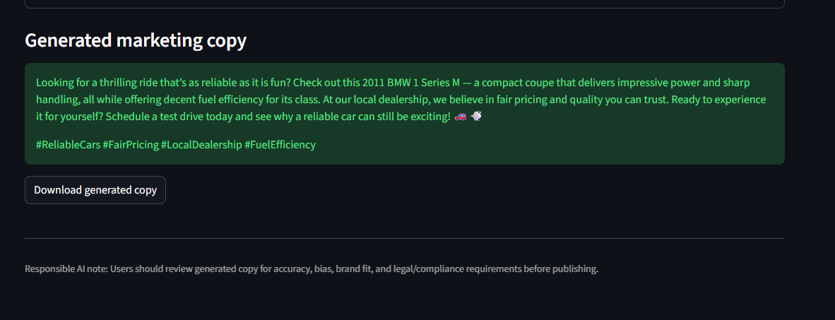
Streamlit app: model output
The generator form collects the same kind of structured input used during fine-tuning.
Fine-tuned model use
The code sends the request to the configured model stored in `FINE_TUNED_MODEL`.
User output Generated copy can be downloaded as a .txt file for review or editing.
Responsible AI The footer reminds users to review accuracy, bias, brand fit, privacy, and compliance.
AI Marketing Content Generator • Streamlit Final Deliverable
05

